Slide 1
Practical Meta-Analysis
David B. Wilson
Evaluators’ Institute
July 16-17, 2010
Practical Meta-Analysis -- D. B. Wilson

Slide 2
Overview of the Workshop
Topics covered will include
  Review of the basic methods
    Problem definition
    Document Retrieval
    Coding
    Effect sizes and computation
    Analysis of effect sizes
    Publication Bias
  Cutting edge issues
  Interpretation of results
  Evaluating the quality of a meta-analysis
Practical Meta-Analysis -- D. B. Wilson

Slide 3
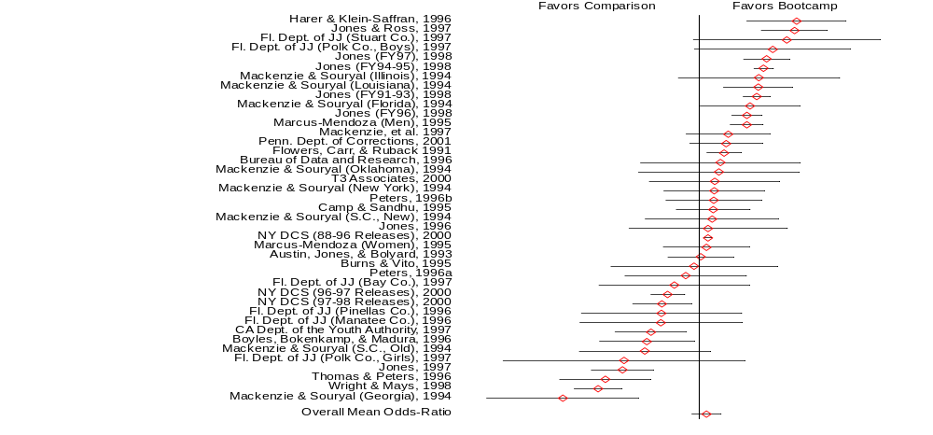
Forest Plot from a Meta-Analysis of
Correctional Boot-Camps
Practical Meta-Analysis -- D. B. Wilson

Slide 4
The Great Debate
1952: Hans J. Eysenck concluded that there were no favorable effects of psychotherapy, starting a raging debate
20 years of evaluation research and hundreds of studies failed to resolve the debate
1978: To proved Eysenck wrong, Gene V. Glass statistically aggregate the findings of 375 psychotherapy outcome studies
Glass (and colleague Smith) concluded that psychotherapy did indeed work
Glass called his method “meta-analysis”
Practical Meta-Analysis -- D. B. Wilson

Slide 5
The Emergence of Meta-analysis
Ideas behind meta-analysis predate Glass’ work by several decades
  Karl Pearson (1904)
    averaged correlations for studies of the effectiveness of inoculation for typhoid fever
  R. A. Fisher (1944)
    “When a number of quite independent tests of significance have been made, it sometimes happens that although few or none can be claimed individually as significant, yet the aggregate gives an impression that the probabilities are on the whole lower than would often have been obtained by chance” (p. 99).
    Source of the idea of cumulating probability values
Practical Meta-Analysis -- D. B. Wilson

Slide 6
The Emergence of Meta-analysis
Ideas behind meta-analysis predate Glass’ work by several decades
  W. G. Cochran (1953)
    Discusses a method of averaging means across independent studies
    Laid-out much of the statistical foundation that modern meta-analysis is built upon (e.g., Inverse variance weighting and homogeneity testing)
Practical Meta-Analysis -- D. B. Wilson

Slide 7
The Logic of Meta-analysis
Traditional methods of review focus on statistical significance testing
Significance testing is not well suited to this task
  Highly dependent on sample size
  Null finding does not carry the same “weight” as a significant finding
    significant effect is a strong conclusion
    nonsignificant effect is a weak conclusion
Meta-analysis focuses on the direction and magnitude of the effects across studies, not statistical significance
  Isn’t this what we are interested in anyway?
  Direction and magnitude are represented by the effect size
Practical Meta-Analysis -- D. B. Wilson

Slide 8
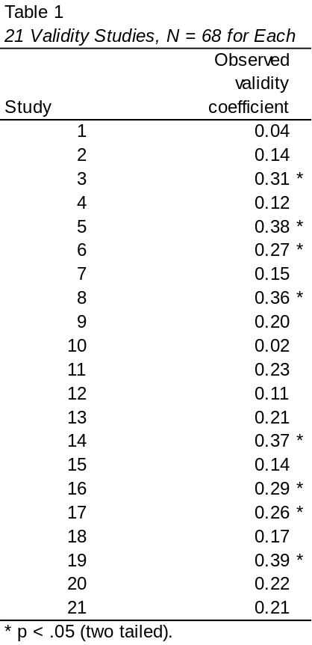
Illustration
Simulated data from 21 validity studies. Taken from: Schimdt, F. L. (1996). Statistical significance testing and cumulative knowledge in psychology: implications for training of researchers. Psychological Methods, 1, 115-129.
Practical Meta-Analysis -- D. B. Wilson

Slide 9
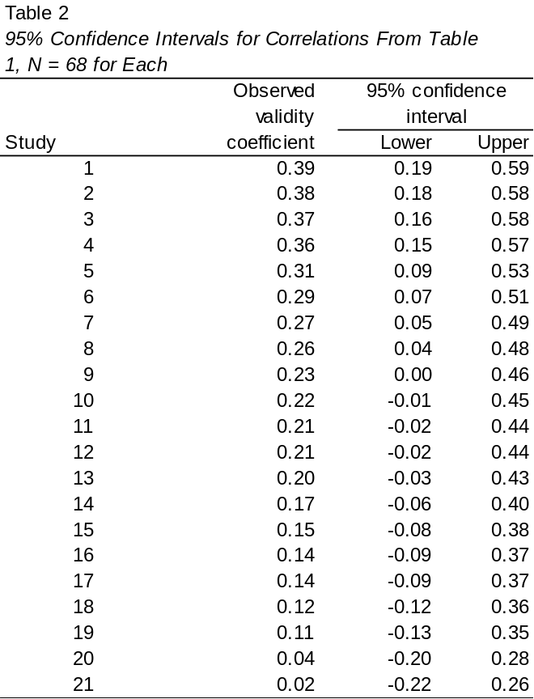
Illustration (Continued)
Practical Meta-Analysis -- D. B. Wilson

Slide 10
When Can You Do Meta-analysis?
Meta-analysis is applicable to collections of research that
  Are empirical, rather than theoretical
  Produce quantitative results, rather than qualitative findings
  Examine the same constructs and relationships
  Have findings that can be configured in a comparable statistical form (e.g., as effect sizes, correlation coefficients, odds-ratios, proportions)
  Are “comparable” given the question at hand
Practical Meta-Analysis -- D. B. Wilson

Slide 11
Forms of Research Findings Suitable to Meta-analysis
Central tendency research
  Prevalence rates
Pre-post contrasts
  Growth rates
Group contrasts
  Experimentally created groups
    Comparison of outcomes between treatment and comparison groups
  Naturally occurring groups
    Comparison of spatial abilities between boys and girls
    Rates of morbidity among high and low risk groups
Practical Meta-Analysis -- D. B. Wilson

Slide 12
Forms of Research Findings Suitable to Meta-analysis
Association between variables
  Measurement research
    Validity generalization
  Individual differences research
    Correlation between personality constructs
Practical Meta-Analysis -- D. B. Wilson

Slide 13
Effect Size: The Key to Meta-analysis
The effect size makes meta-analysis possible
  It is the “dependent variable”
  It standardizes findings across studies such that they can be directly compared
Practical Meta-Analysis -- D. B. Wilson

Slide 14
Effect Size: The Key to Meta-analysis
Any standardized index can be an “effect size” (e.g., standardized mean difference, correlation coefficient, odds-ratio) as long as it meets the following
  Is comparable across studies (generally requires standardization)
  Represents the magnitude and direction of the relationship of interest
  Is independent of sample size
Different meta-analyses may use different effect size indices
Practical Meta-Analysis -- D. B. Wilson

Slide 15
The Replication Continuum
Pure
Replications
Conceptual
Replications
You must be able to argue that the collection of studies you are meta-analyzing examine the same relationship. This may be at a broad level of abstraction, such as the relationship between criminal justice interventions and recidivism or between school-based prevention programs and problem behavior. Alternatively it may be at a narrow level of abstraction and represent pure replications.
The closer to pure replications your collection of studies, the easier it is to argue comparability.
Practical Meta-Analysis -- D. B. Wilson

Slide 16
Which Studies to Include?
It is critical to have an explicit inclusion and exclusion criteria (see pages 20-21)
  The broader the research domain, the more detailed they tend to become
  Refine criteria as you interact with the literature
  Components of a detailed criteria
    distinguishing features
    research respondents
    key variables
    research methods
    cultural and linguistic range
    time frame
    publication types
Practical Meta-Analysis -- D. B. Wilson

Slide 17
Methodological Quality Dilemma
Include or exclude low quality studies?
  The findings of all studies are potentially in error (methodological quality is a continuum, not a dichotomy)
  Being too restrictive may restrict ability to generalize
  Being too inclusive may weaken the confidence that can be placed in the findings
  Methodological quality is often in the “eye-of-the-beholder”
  You must strike a balance that is appropriate to your research question
Practical Meta-Analysis -- D. B. Wilson

Slide 18
Searching Far and Wide
The “we only included published studies because they have been peer-reviewed” argument
Significant findings are more likely to be published than nonsignificant findings
Critical to try to identify and retrieve all studies that meet your eligibility criteria
Practical Meta-Analysis -- D. B. Wilson

Slide 19
Searching Far and Wide (continued)
Potential sources for identification of documents
  Computerized bibliographic databases
  “Google” internet search engine
  Authors working in the research domain (email a relevant Listserv?)
  Conference programs
  Dissertations
  Review articles
  Hand searching relevant journal
  Government reports, bibliographies, clearinghouses
Practical Meta-Analysis -- D. B. Wilson

Slide 20
A Note About Computerized Bibliographies
Rapidly changing area
Get to know your local librarian!
Searching one or two databases is generally inadequate
Use “wild cards” (e.g., random? will find random, randomization, and randomize)
Throw a wide net; filter down with a manual reading of the abstracts
Practical Meta-Analysis -- D. B. Wilson

Slide 21
Strengths of Meta-analysis
Imposes a discipline on the process of summing up research findings
Represents findings in a more differentiated and sophisticated manner than conventional reviews
Capable of finding relationships across studies that are obscured in other approaches
Protects against over-interpreting differences across studies
Can handle a large numbers of studies (this would overwhelm traditional approaches to review)
Practical Meta-Analysis -- D. B. Wilson

Slide 22
Weaknesses of Meta-analysis
Requires a good deal of effort
Mechanical aspects don’t lend themselves to capturing more qualitative distinctions between studies
“Apples and oranges” criticism
Most meta-analyses include “blemished” studies to one degree or another (e.g., a randomized design with attrition)
Selection bias posses a continual threat
  Negative and null finding studies that you were unable to find
  Outcomes for which there were negative or null findings that were not reported
Analysis of between study differences is fundamentally correlational
Practical Meta-Analysis -- D. B. Wilson

